Slide 1


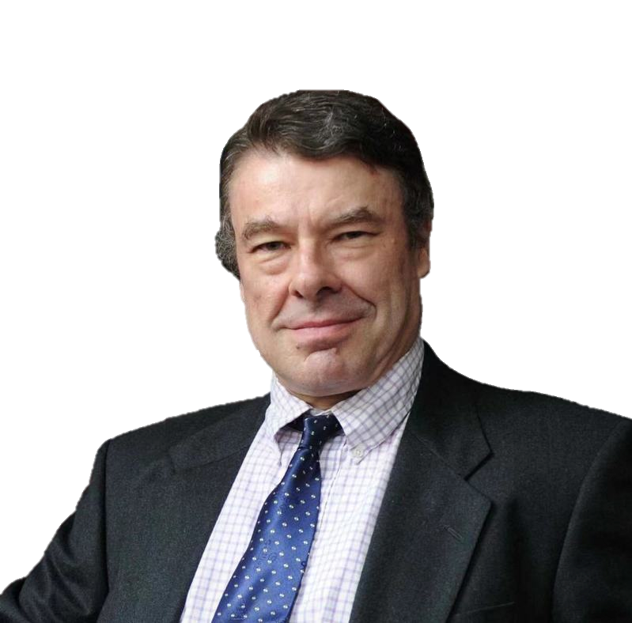


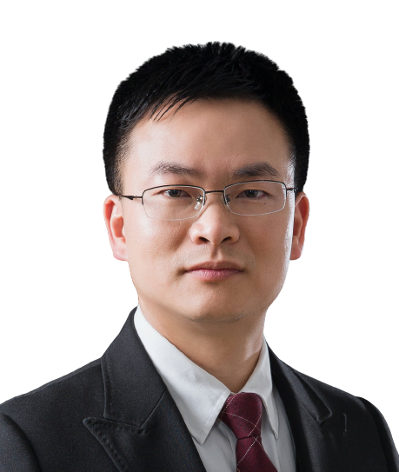
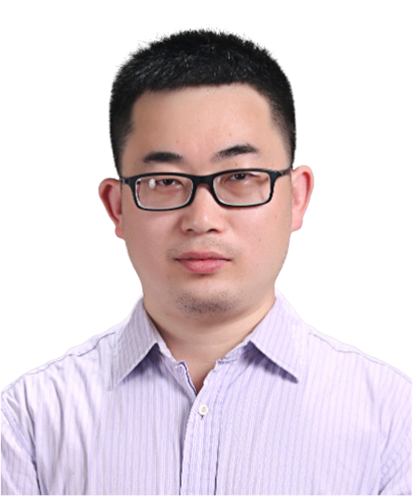
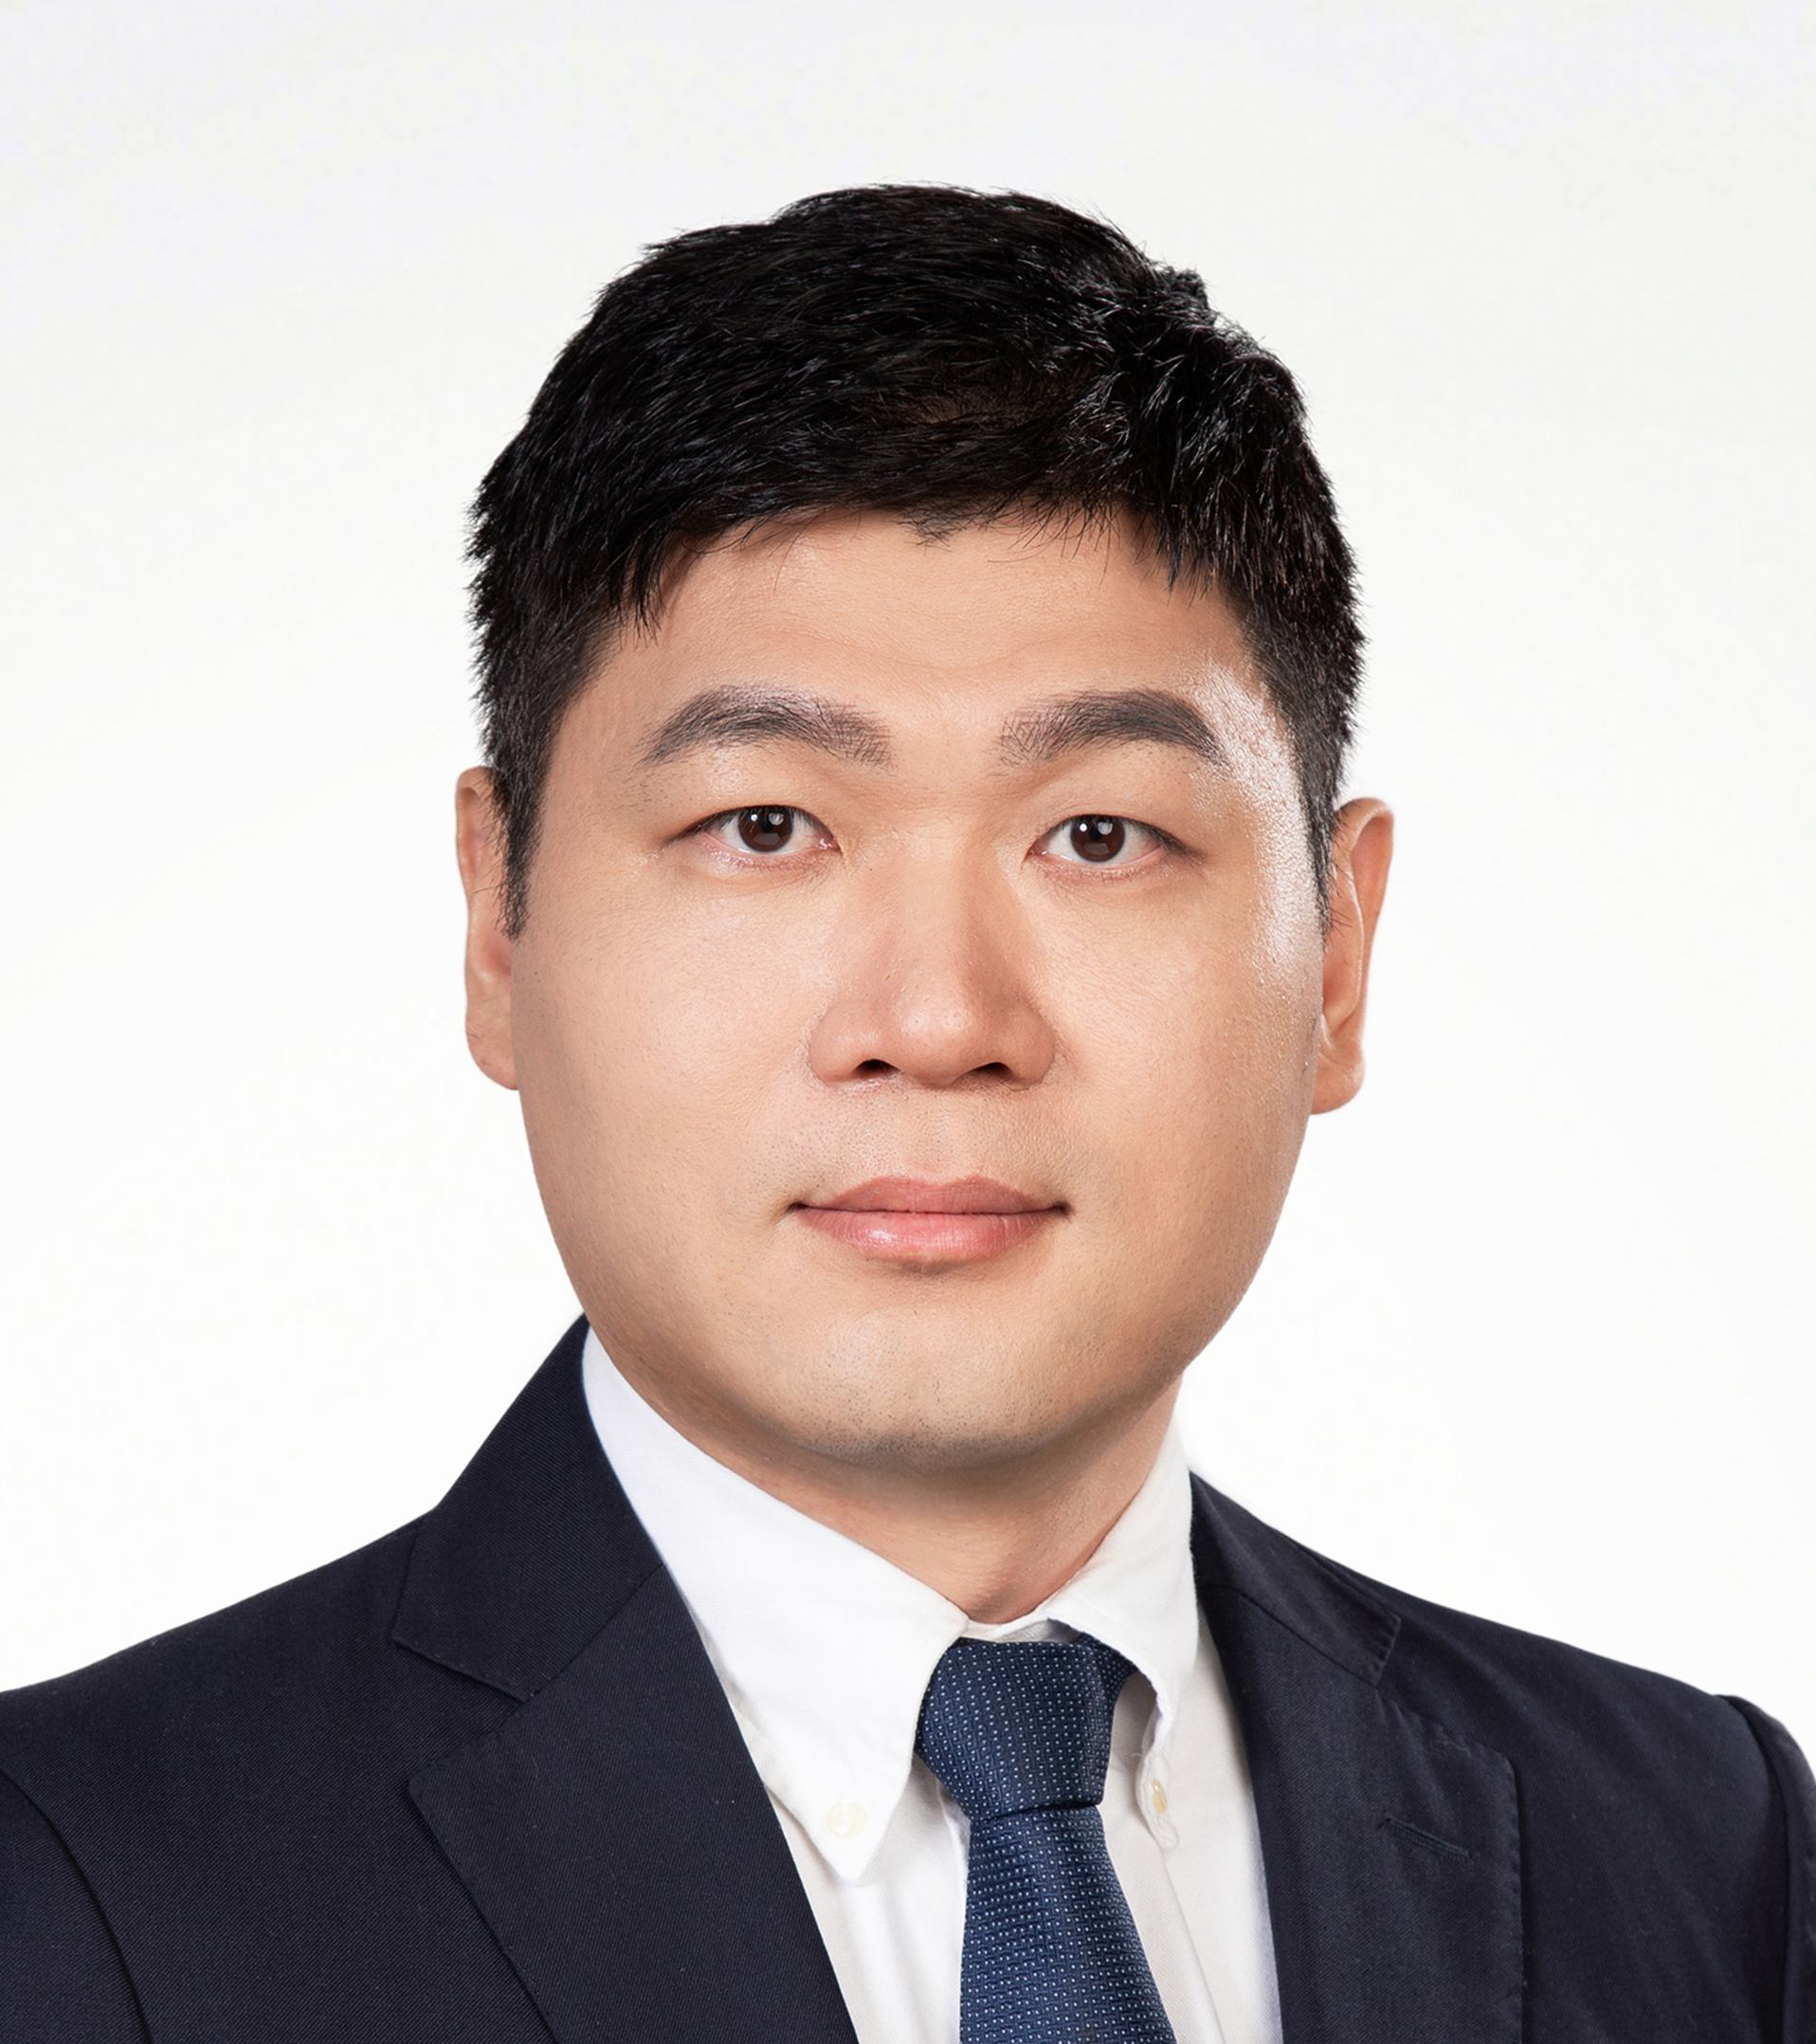
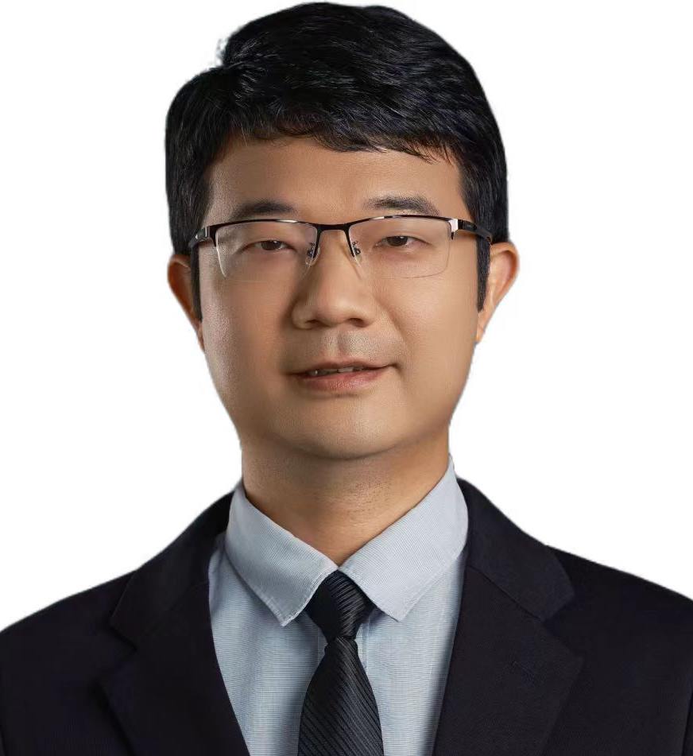
辅因子结合触发甲基转移酶核酶活性位点的快速构象重塑
报告时间: 2024-6-27 19:00
腾讯会议: 284-568-908
bilibili：https://live.bilibili.com/26427894
Alastair Murchie
复旦大学 教授
汇报人简介:
Alastair Murchie教授，复旦大学生物医学研究院教授、博士生导师。1994年博士毕业于英国邓迪大学生物化学与分子生物学系，1994-1998年作为博士后及资深科研人员就职于英国邓迪大学生物化学系，1998-2003年担任英国剑桥新药开发公司Ribotargets首席研发，2003-2005年担任法国巴黎巴斯德研究所，新药开发公司Ariana pharmac首席研发。Murchie教授的主要研究方向是（1）核酸高级结构及核酸生物学功能的研究，包括：核糖开关RNA和新型核酶RNA的发现，结构和功能以及对基因表达和调控的影响， RNA的修饰及其生物学功能，RNA表观遗传学在疾病中和干细胞中的研究。（2）非编码RNA和小分子相互作用调控抗生素耐药性基因的表达。荣获2015年上海市“白玉兰纪念奖”。
HOST＆PANELISTS
Host： Lin Huang
Sun Yat-sen University
Jinkai Wang
Sun Yat-sen University
Zhichao Miao
Guangzhou Laboratory
Guangzhou Medical University
Liang Xu
Sun Yat-sen University

Slide 2
Cofactor Binding Triggers Rapid Conformational Remodelling of the Active Site of a Methyltransferase Ribozyme
Time (China): 2024-6-27 19:00
Time (UK): 2024-6-27 12:00
Tencent Meeting: 284-568-908
bilibili：https://live.bilibili.com/26427894
Dr. Alastair Murchie
Fudan University
Introduction:
Professor Alastair Murchie, Professor and PhD Supervisor of the Institute of Biomedical Sciences, Fudan University, graduated from the Department of Biochemistry and Molecular Biology, University of Dundee, UK, in 1994, and worked as a postdoctoral fellow and senior researcher at the Department of Biochemistry, University of Dundee, UK, in 1994-1998, and as Chief R&D Officer of Ribotargets, a new drug development company in Cambridge, UK, in 1998-2003. Professor Murchie's main research interests are (1) Advanced structure and biological function of nucleic acids, including the discovery of novel riboswitches and ribozymes, their structure and function, and their impact on gene expression and regulation, effects on gene expression and regulation, RNA modification and its biological functions, RNA epigenetics in disease and stem cells. (2) Interaction between non-coding RNAs and small molecules regulates the expression of antibiotic resistance genes. He was awarded the 2015 Shanghai Magnolia Memorial Prize.
HOST＆PANELISTS
Host： Lin Huang
Sun Yat-sen University
Jinkai Wang
Sun Yat-sen University
Zhichao Miao
Guangzhou Laboratory
Guangzhou Medical University
Liang Xu
Sun Yat-sen University

